Slide 1






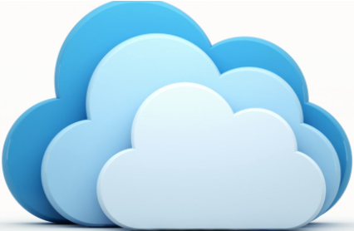
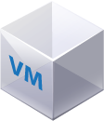











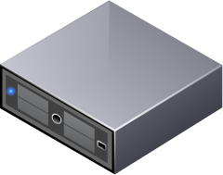

Customer On-Premises
Datacenter
Oracle Cloud Infrastructure (Region)
HCI Interconnect to OCI
Availability Domain
Fault Domain 1
Fault Domain 2
Fault Domain 3
VCN
DNAT / SNAT
T0 Router with ECMP
1. Edge North South Rules & 2. Inter T1 Rules
Internet Gateway
T1 Router
DFW - East West Rules
T1 Router
DFW - East West
Rules
T1 Router
DFW - East West Rules
Web Server
Finance
Sales
Engineering
App Server
Router
Subnet A
Subnet B
Subnet C
Subnet D
Subnet E
Dynamic Routing Gateway
NSX Overlay Customer Logical Segments
Storage Policies
FastConnect
OCI – Virtual Cloud Network
COMPUTE (vSphere)
NETWORK
(NSX-T)
STORAGE (vSAN)
Service Gateway
DNS
NSG
BM.DenseIO2.52 - OCI Compute Cluster
DNS
ID & Access
Management
Database System
Object Storage
Security
Fiber Channel/iSCSI or vSAN

Slide 2
Compute
# In each BM.DenseIO2.52 Server consists of
Total Cores 52
Total Storage 51.2TB
# Considering all Database’s and other Workloads demands, including growth, overhead we will use 18 Number of Host (6 in Each Cluster), this can be easily scale up.
BM.DenseIO2.52 Instances on Oracle Cloud Infrastructures.
Total Compute Resources 936 Cores & 921.6 TB
# 1) How will the customer migrate from on-prem to the cloud?
Migrating VMware Workloads to the Oracle Cloud can be easily achieved using VMware HCX Solution this is useful for Applications, Non-Oracle Database migration, network extension, cross-cloud connectivity, for live or bulk migration of production workloads, without disruption to the business entities that depend on mission-critical applications running in their on-premises VMware environment by building an abstraction layer on top of existing site-specific implementations of Oracle Cloud Infrastructure using VMware HCX ensuring the dedicated network port requirements are opened.
HCX uses the Oracle Cloud Infrastructure FastConnect service for connectivity between your on-premises network and Oracle Cloud VMware Solution. FastConnect provides low-latency, high-throughput network connectivity with 1-Gbps and 10-Gbps port speeds, which helps to deliver seamless experience in hybrid cloud operations.

Slide 3
# 2) How do you meet the access requirements by the different lines of business?
Oracle Cloud Infrastructure Identity and Access Management (IAM) Service lets you control who has access to your cloud resources. You control the types of access a group of users has and to which specific resources.
However, I believe the question is specific to systems access over network.
Oracle Cloud Infrastructure VCN, which is configured with different gateways to communicate with the on-premises network and other Oracle Cloud Infrastructure services.
To achieve our purpose for all the Line of Business access, restrictions can be segregated configuring DFWs in NSX to segregate the workloads. NSX DFW is a stateful firewall, meaning it monitors the state of active connections and uses this information to determine which network packets to allow through the firewall. DFW is implemented in the hypervisor and applied to virtual machines on a per-vNIC basis. That is, the firewall rules are enforced at the vNIC of each virtual machine. Inspection of traffic happens at the vNIC of a VM just as the traffic is about to exit the VM and enter the virtual switch (egress). Inspection also happens at the vNIC just as the traffic leaves the switch but before entering the VM (ingress).
The DFW rules can be based on Layer 2 (L2) up to Layer 4 (L4).
Layer 2 (L2) rules (Ethernet tab) are based on MAC address L2 protocols like ARP, RARP and LLDP
Layer 3 (L3) rules (General tab) are based on Ip source destination
Layer 4 (L4) uses a TCP or UDP service port
L2 (Ethernet) firewall rules are processed before L3 rules. The default firewall rule allows L2 and L3 traffic to pass through your VDCs. Once you've implemented all the rules, you can change this to block. Rules are always read and enforced from top-to-bottom ordering like any traditional firewall.
DFW rules can have one or more of the following entities as the source or destination: Org VDC networks, virtual machines, Org VDCs, MAC sets (L2 – Ethernet), IP sets (L3 – General) or security groups.

Slide 4
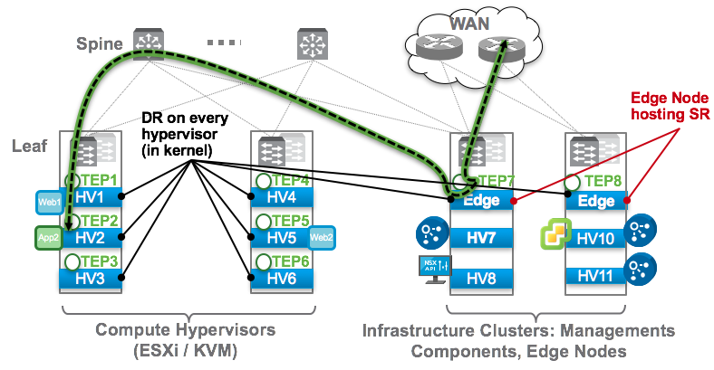
# 3) Document the NSX Edge firewall / DFW firewall topology.
NSX-T Edge Firewall / DFW Firewall
Edge services can be deployed as a separate Edge cluster or integrated deployment.
If we have a dedicated Edge Cluster, where all the traffic is routed via an Edge VM and Firewall is maintained as a services on it, and the traffic is filtered on the VM, then it’s called an Edge Firewall (Black Dashed Line with Green Highlight)
If the Edge Nodes are deployed in a Collapsed Architecture and as an appliance and we use the Firewall on the T1, then it’s a Distributed Firewall, which works basically at the VM NIC level and not having to route all traffic through one VM for filtering (DR – Distributed Routing on every hypervisor)

Slide 5
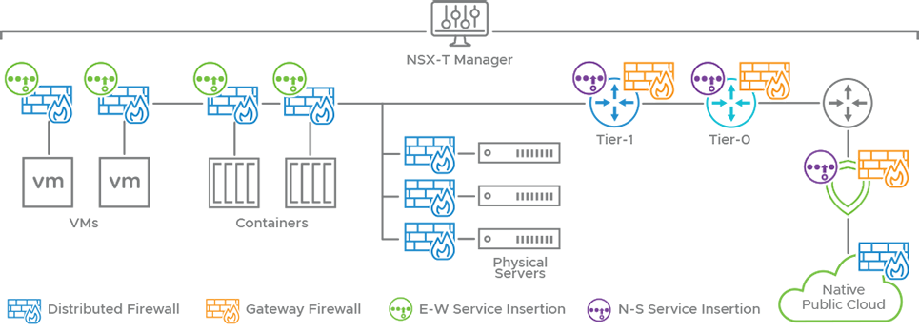
VMware NSX-T T0 & T1 Topology
# 4) Document the NSX T0 and T1 topology
NSX-T has 2 Tiers in Edge
T0 – For External Connectivity
T1 – For Internal connectivity
T0s are usually used in external connectivity to upstream switches and better to maintain North South Firewall on T0 and inter T1 Firewalling can also be maintained here. NSX-T Logical Router (SR). The SR component of the NSX-T Tier-0 Logical Router is responsible for establishing eBGP peering with the PLR and enabling North-South routing.
For Separation of Traffic and easy management we can have multiple T1s assigned for individual Departments or Zones like Prod, UAT etc. and maintain East-West Traffic within the T1s logical segments
NSX-T Logical Router (DR). The DR component of the NSX-T Logical Router is responsible for East- West routing.
VLAN Traffic
VLAN Traffic
Router2
Router1
External2-VLAN
4x BGP peering between both Physical-Routers
and both Tier0-SRs Edge Nodes.
External1-VLAN
Physical Layer
Virtual Layer
EN1
EN2
Tier0
Tier1
SR
Overlay
Traffic
SR – Service Router
DR – Distributed Router
DR
DR

Slide 6
# 5) What storage optimizations can you make to ensure the availability of the critical databases?
vSAN converged storage technology ensures the availability of data and replicates data across all the bare metal hosts in the SDDC, provides a single shared datastore (vsanDatastore) for compute and management workloads (VMs). vSAN storage solution built on NVMe-backed bare metal instance storage that offers high performance, low latency, and robust block storage capability without the need of traditional SAN.
vSAN implements fault domains, which are different from Oracle Cloud Infrastructure fault domains. vSAN fault domains let vSAN group multiple hosts (typically within the same chassis or rack) into a logical boundary domain. The fault domains setting ensures that multiple replica copies of storage objects are distributed across the domains. If an entire domain (chassis or rack) fails, only one replica is affected.
vSAN storage policies are used to determine the high availability of individual VMs. You can configure different policies in Oracle Cloud VMware Solution to determine the number of host and device failures that a VM can tolerate.
Currently OCVS does not support vSAN Stretched cluster scenario hence we would have to enable FTT that defines the number of host and device failures that a virtual machine can tolerate. You can choose to have no data redundancy, or select a RAID configuration optimized for either performance (Mirroring) or capacity (Erasure Coding).
My recommendation: RAID-1 uses more disk space to place the components of objects but provides better performance for accessing the objects.
As RAID-5/6 (Erasure Coding) uses less disk space, but the performance is reduced.
The number of failures to tolerate (FTT), will determine how many copies of the object will be required. For example: FTT=1 is 2 copies, FTT=2 is 3 copies, and FTT=3 is 4 copies. This count includes the original object itself but not the witness.

Slide 7
# 6) How do you solve for HA/DR for this use case?
vCenter Server management software has a capability of VM High Availability feature and configuration need to be enabled on the Cluster level.
For Oracle DB’s utilizing the native Oracle DBaaS feature is the best fit within OCI; If we have MS SQL DB’s, its good to use SQL Server Groups and create HA\DRS rules to keep them on separate Hosts.
For Disaster recovery and business continuity: In the Design Diagram, I didn’t add another Region, to achieve Disaster Recovery Customer should consider to have another SDDC Region within OCVS, Customer can BYOL have VMware vSphere SRM to utilize the robust orchestration capabilities or use HCX to replicate the data.
[. Oracle Cloud VMware Solution doesn’t provide an SRM license as part of the universal credit subscription & currently it does not support Array Based replication. Only vSphere Replication]

